Slide 1
System Analysis and Design Chapter 2: Planning
By:
AMIR MAHARJAN and
BISESH ADHIKARI

Slide 2
System Development Projects
The planning phase of the SDLC is also when the project plan is developed that identifies, prioritizes, and assigns the tasks and resources required to build the structure for a project
The first phase in SDLC is Planning and it is categorized into two groups
Identification and selection
Initiation and planning

Slide 3
1. Identification and Selection
During this, a senior manager, etc. Identifies and assesses all possible projects the organization can undertake.
Those projects that are likely to benefit the organization are selected.
A large organization may follow a formal project identification process where all the projects are compared and the most beneficial one is selected.
A small organization may not follow a formal organization. The high-ranking manager may decide which project to select.

Slide 4
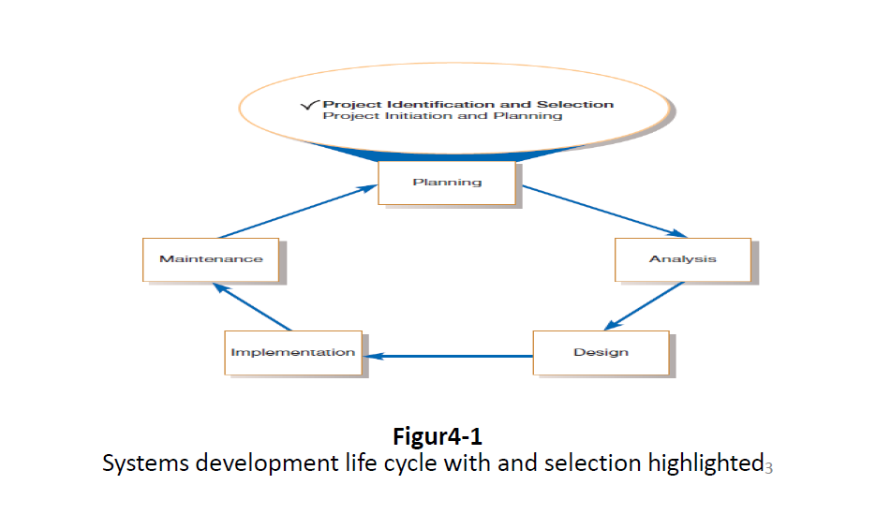

Slide 5
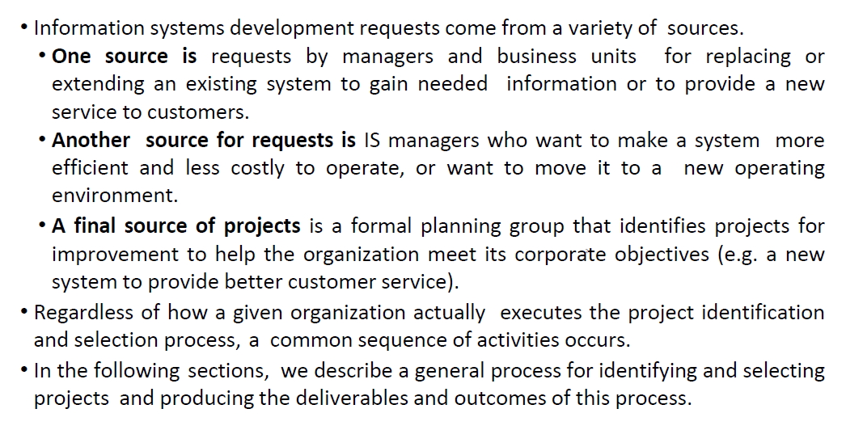

Slide 6
Process of Identifying and selecting projects
Project identifying and selecting consists of three primary activities, they are:
1. Identifying potential development projects
2. Classifying and ranking development projects
3. Selecting development projects

Slide 7
1. Identifying Potential Development Projects
Different organization may have different way of identifying the projects.
This process can be performed by a top executives like CEO in a small organization.
In large organization, it can be performed by department head (HOD), senior IS manager.
All methods of identification have strength and weakness.
Project identified by top management focuses on strategic organization and projects identified by steering committee focuses on cross-function.
Project cost, duration, complexity and risk are influenced by the source.

Slide 8
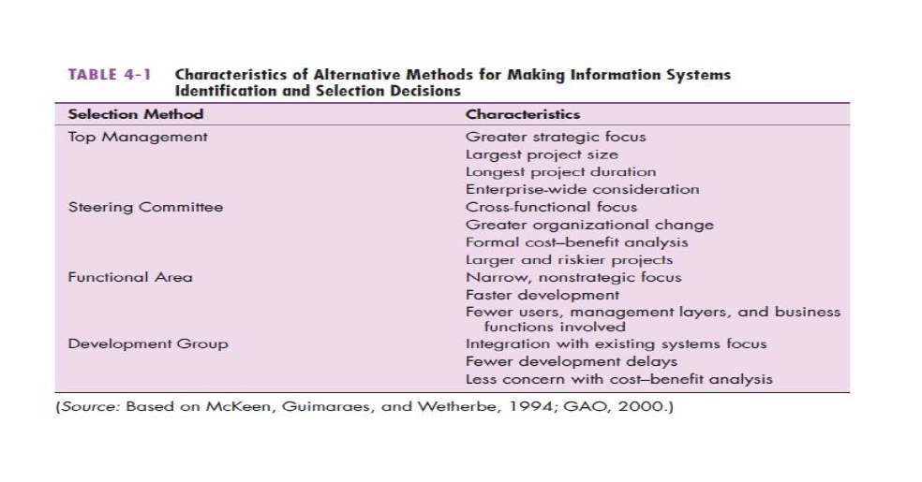

Slide 9
2. Classifying and Ranking Development Projects
The second major activity in the project identification and selection process focuses on assessing (to judge or decide the amount, value, quality or importance of something )the relative merit of potential projects. As with the project identification process, classifying and ranking projects can be performed by top managers, a steering committee, business units, or the IS development group. Additionally, the criteria used when assigning the relative merit of a given project can vary.

Slide 10
3. Selecting Development Projects
The final activity in the project identification and selection process is the actual selection of projects for further development.
Project selection is a process of considering both short- and long-term projects and selecting those most likely to achieve business objectives.
Additionally, as business conditions change over time, the relative importance of any single project may substantially change. Thus, the identification and selection of projects is a very important and ongoing activity.

Slide 11
Corporate and Information System Planning
Organizations have not traditionally used a systematic planning process when determining how to allocate IS resources.
The difficulty with this approach is that the required organizational procedures are likely to change over time as the environment changes.
For example, a company may decide to change its method of billing customers or a university may change its procedure for registering students.
When such changes occur, it is usually necessary to again modify existing information systems.

Slide 12
Corporate Strategic Planning
A prerequisite for making effective project selection decisions is to gain a clear idea of where an organization is, its vision of where it wants to be in the future, and how to make the transition to its desired future state. Figure 4-6 represents this as a three-step process.
The first step focuses on gaining an understanding of the current enterprise. In other words, if you don’t know where you are, it is impossible to tell where you are going.
Next, top management must determine where it wants the enterprise to be in the future.
Finally, after gaining an understanding of the current and future enterprise, a strategic plan can be developed to guide this transition.

Slide 14
Information System Planning
The second planning process that can play a significant role in the quality of project identification and selection decisions is called information system planning (ISP).
ISP is and orderly means of assessing the information needs of an organization and defining the information systems, databases, and technologies that will best satisfy those needs.
This means that during ISP you (or, more likely, senior IS managers responsible for the IS plan) must model current and future organization informational needs and develop strategies and project plans to migrate the current information systems and technologies to their desired future state.
ISP is a top-down process.

Slide 15
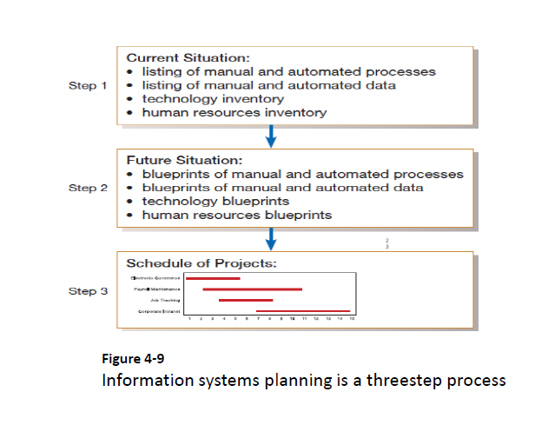

Slide 16
2. Initiation and Planning
The first, project identification and selection, focuses on the activities during which the need for a new or enhanced system is recognized. Thus, project identification and selection is often thought of as a “pre project” step in the life cycle.
The next step is to conduct a more detailed assessment during project initiating and planning. This assessment does not focus on how the proposed system will operate but rather on understanding the scope of a proposed project and its feasibility of completion given the available resources.
In the next section, the project initiation and planning process is briefly reviewed. Numerous techniques for assessing project feasibility are then described.

Slide 17
Initiating and Planning System Development Projects
A key consideration when conducting project initiation and planning (PIP) is deciding when PIP ends and when analysis, the next phase of the SDLC, begins. This is a concern because many activities performed during PIP could also be completed during analysis.

Slide 18
Process of Initiating and Planning IS Development Projects
Project initiation focuses on activities designed to assist in organizing a team to conduct project planning. During initiation, one or more analysts are assigned to work with a customer—that is, a member of the business group that requested or will be affected by the project—to establish work standards and communication procedures.
Examples of the types of activities performed are shown in Table 5-1. Depending upon the size, scope, and complexity of the project, some project initiation activities may be unnecessary or may be very involved. Also, many organizations have established procedures for assisting with common initiation activities.

Slide 19
Project planning is the process of defining clear, discrete activities and the work needed to complete each activity within a single project. The objective of the project planning process is the development of a Baseline Project Plan (BPP) and the Project Scope Statement (PSS) (Morris and Sember, 2008). The BPP becomes the foundation for the remainder of the development project. The PSS produced by the team clearly outlines the objectives and constraints of the project for the customer. As with the project initiation process, the size, scope, and complexity of a project will dictate the comprehensiveness of the project planning process and resulting documents. Further, numerous assumptions about resource availability and potential problems will have to be made. Analysis of these assumptions and system costs and benefits forms a business case. The range of activities performed during project planning is listed.

Slide 20
Assessing Project Feasibility
All projects are feasible given unlimited resources and infinite time (Pressman, 2014). Unfortunately, most projects must be developed within tight budgetary and time constraints. This means that assessing project feasibility is a required activity for all information systems projects and is a potentially large undertaking. It requires that you, as a systems analyst, evaluate a wide range of factors. Typically, the relative importance of these factors will vary from project to project.
Most feasibility factors are represented by the following categories:
Economic
Technical
Operational
Scheduling
Legal and Contractual
Political

